Slide 1
ALGEBRA 4
Day 62

Slide 2
ACT DAY 2
ACT Prep Guidelines
Math Mini Test 1
Math Mini Test 2
Go Over Mini Tests
Mini Test 3 (in class/take home)

Slide 3
How many questions are on the math test?
TOTAL OF 60 questions, 60 minutes
Pre-algebra 14
Elementary algebra 10
Intermediate algebra 9
Coordinate geometry 9
Plane geometry 14
Trigonometry 4

Slide 4
These 6 sections are split into 3 sub scores
Pre-Algebra and Elementary Algebra
Intermediate Algebra and Coordinate Geometry
Plane Geometry and Trigonometry
You’ll be able to identify how many of each sub category you got correct, and therefore know which areas need more attention

Slide 5
Pre-Algebra (20-25%)
Ratio, proportion, and percent
Linear equations in one variable
Absolute value and ordering numbers by value
Elementary counting techniques and simple probability
Data collection, representation, and interpretation
Understanding simple descriptive statistics
Basic operations using whole numbers, decimals, fractions, and integers
Place value
Square roots and approximations
The concept of exponents
Scientific notation
Factors

Slide 6
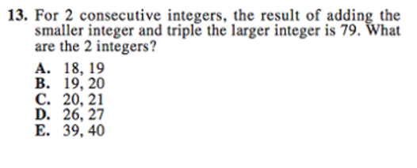

Slide 7
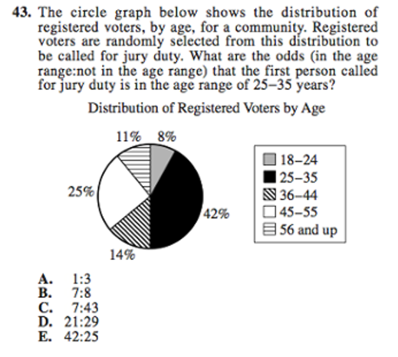

Slide 8
Elementary Algebra (15-20%)
Properties of exponents and square roots
Evaluation of algebraic expressions through substitution
Using variables to express functional relationships
Understanding algebraic operations
The solution of quadratic equations by factoring

Slide 9
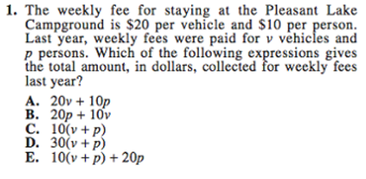

Slide 10
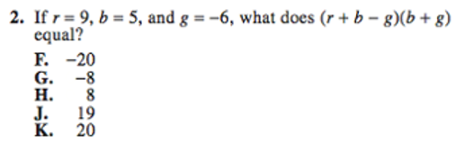

Slide 11
Intermediate Algebra (15-20%)
The quadratic formula
Rational and radical expressions
Absolute value equations and inequalities
Sequences and patterns
Systems of equations
Quadratic inequalities
Functions and modeling
Matrices
Roots of polynomials
Complex numbers

Slide 12
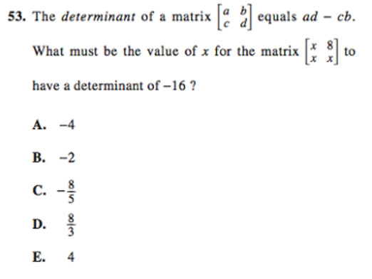

Slide 13
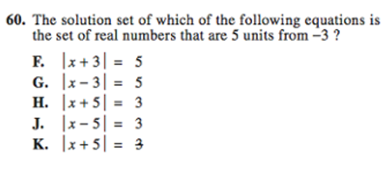

Slide 14
Coordinate Geometry (15-20%)
Graphing and the relations between equations and graphs, including points, lines, polynomials, circles, and other curves
Graphing inequalities
Slope
Parallel and perpendicular lines
Distance
Midpoints
Conics

Slide 15
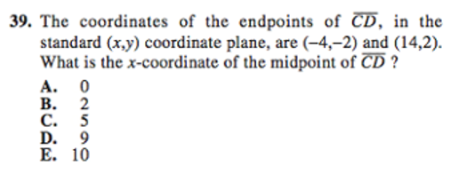

Slide 16
Plane Geometry (20-25%)
Properties and relations of plane figures, including angles and relations among perpendicular and parallel lines
Properties of circles, triangles, rectangles, parallelograms, and trapezoids
Transformations
The concept of proof and proof techniques
Volume
Applications of geometry to three dimensions

Slide 17
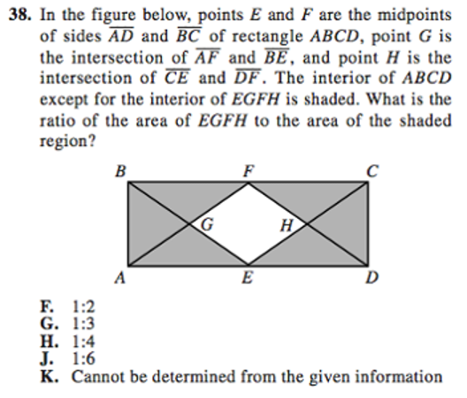

Slide 18
Trigonometry (5-10%)
Trigonometric relations in right triangles
Values and properties of trigonometric functions
Graphing trigonometric functions
Modeling using trigonometric functions
Use of trigonometric identities
Solving trigonometric equations

Slide 19
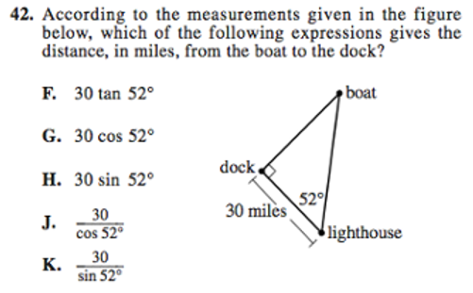

Slide 20
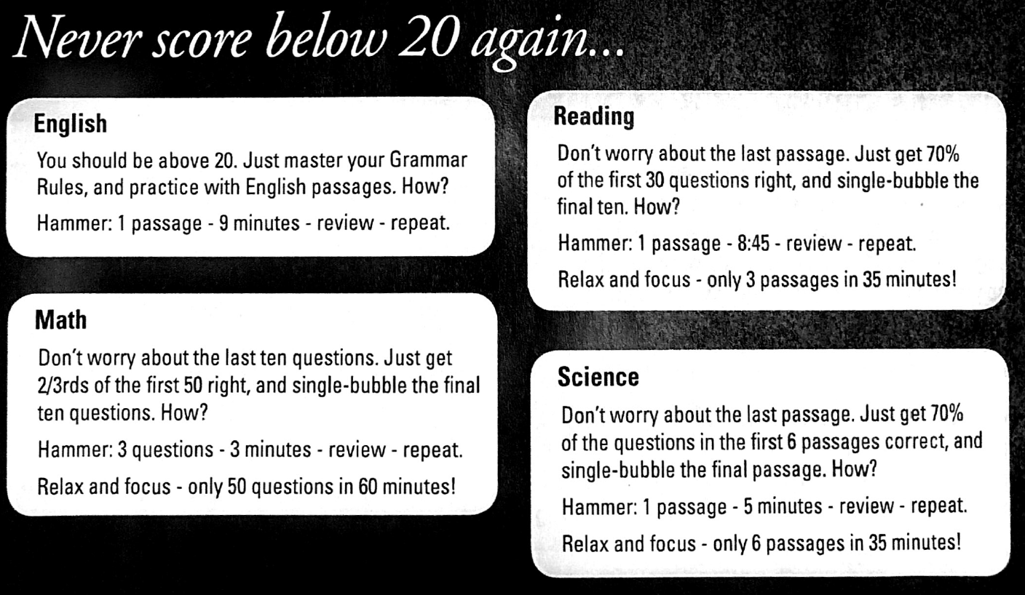

Slide 21
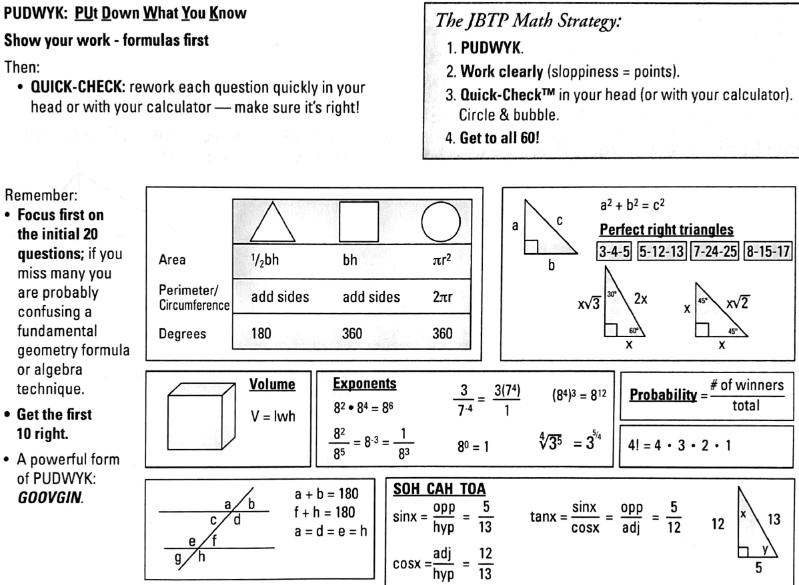

Slide 22
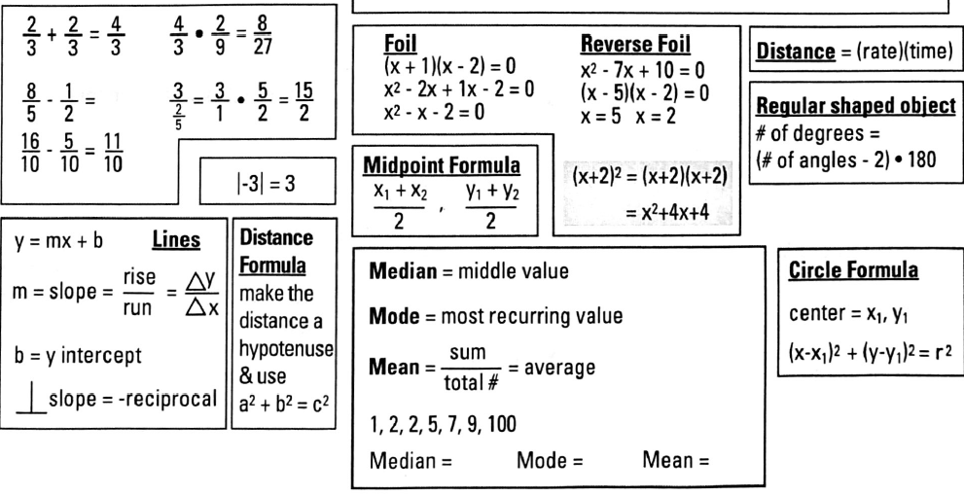

Slide 23
Mini Test 1
We’ll set a timer for 10 minutes.
Complete as many of the 10 problems as you can.
Be honest with yourself.

Slide 24
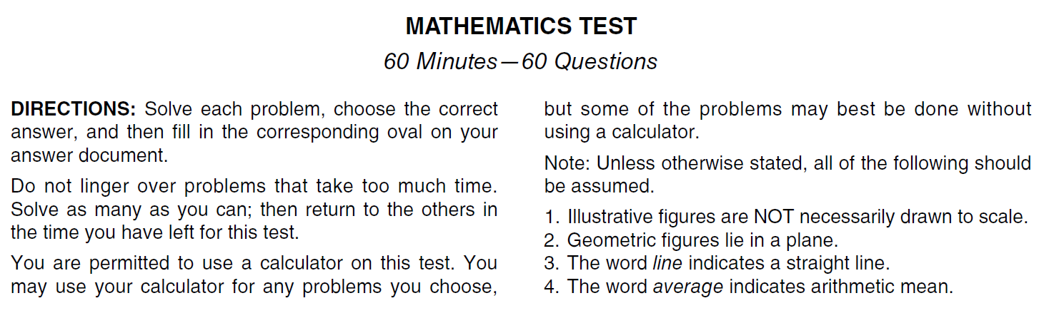
Read the Directions before the Test Day

Slide 25
Mini Test 2
We’ll set a timer for 10 minutes.
Complete as many of the 10 problems as you can.
Be honest with yourself.

Slide 26
Read the Directions before the Test Day

Slide 27
Go Over Mini Test 1 and Mini Test 2
Common Mistakes
Ways we could have eliminated some solutions
Formulas used

